Slide 1
Commercial PACE Financing Introduction
Efficient Capital for Efficient Projects
v2

Slide 2
What is C-PACE?
Cost Effective Capital for Efficient Projects
Commercial Property Assessed Clean Energy
Commercial = industrial, multifamily, office, mixed-use, retail, hospitality, healthcare, nonprofit
Property Assessed = the C-PACE loan is repaid as a special assessment on the property and collected in the same manner as property taxes.
Clean Energy = C-PACE funds energy efficiency, renewable energy, water conservation, and resiliency improvements in commercial properties.
2

Slide 3
How It Works
A Game-Changer for Development Finance
1 2
3
States pass legislation authorizing C-PACE financing, administrators are selected to regulate the C-PACE program, taxing authorities (counties, cities) may choose to opt into the program
Developers secure financing from a private C-PACE lender, alongside senior construction loan and equity
Assessment P&I is repaid via a special assessment on the property tax bill
C-PACE is a public-private partnership enabled by state and local legislation, allowing private lenders to provide financing for measures that improve building energy performance.
4

Slide 4
C-PACE Financing
C-PACE Financing is a low-cost, long-term financing vehicle that makes investing in energy efficiency, water efficiency, renewable energy, and resiliency projects more affordable for property owners and developers.
C-PACE Financing is beneficial for:
new construction
building retrofits
gut rehabilitations
upgrades to existing building
refinance within 2 years after completion
Up to 25% LTV
Up to
30-yr Terms
Fixed-Rate
Low-Cost

Slide 5
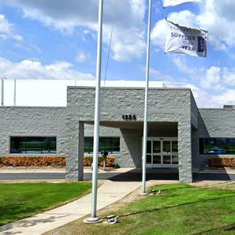
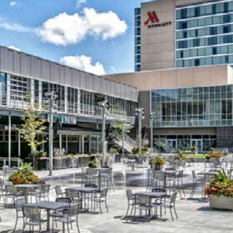
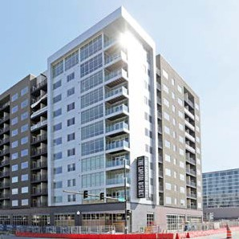
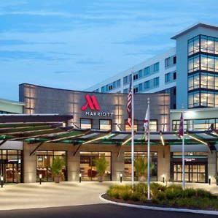
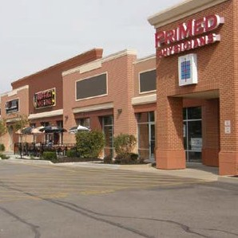
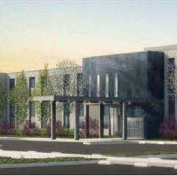
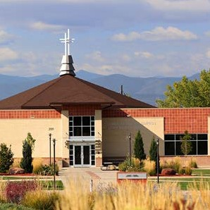
Who Benefits From C-PACE?
Property Types
C-PACE can fund projects for a wide variety of commercial property types.
OFFICE
INDUS TRIAL
MIXED- USE
MU LTI FA MI LY
HOSPI TALITY
RE TAIL
HE ALTHCARE
N ON PROF I T

Slide 6
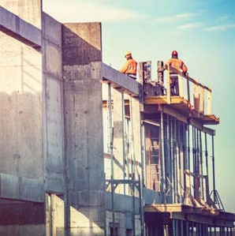
Eligible Upgrades
Typical Measures Funded by C-PACE
ENER GY EFFICIENCY
RENEWABLE ENER GY
WATER EFFICIENCY
Low-flow plumbing fixtures
Irrigation sensors/ controls
Greywater/wastewater recovery
Water-efficient appliances (permanently affixed)
Rainwater harvesting
RE SILIENCY
HVAC systems
Boilers & chillers
Building automation & control systems
Solar/solar thermal
Fuel cells
Cogeneration
Geothermal
Wind
Seismic
Wind-hardening
Microgrids
C-PACE financing can be used for seismic upgrades in California, Oregon, and Alaska, and wind-hardening upgrades in Florida
LED lighting
Building envelope, including insulation, windows, doors & roofing
Motors & drives

Slide 7
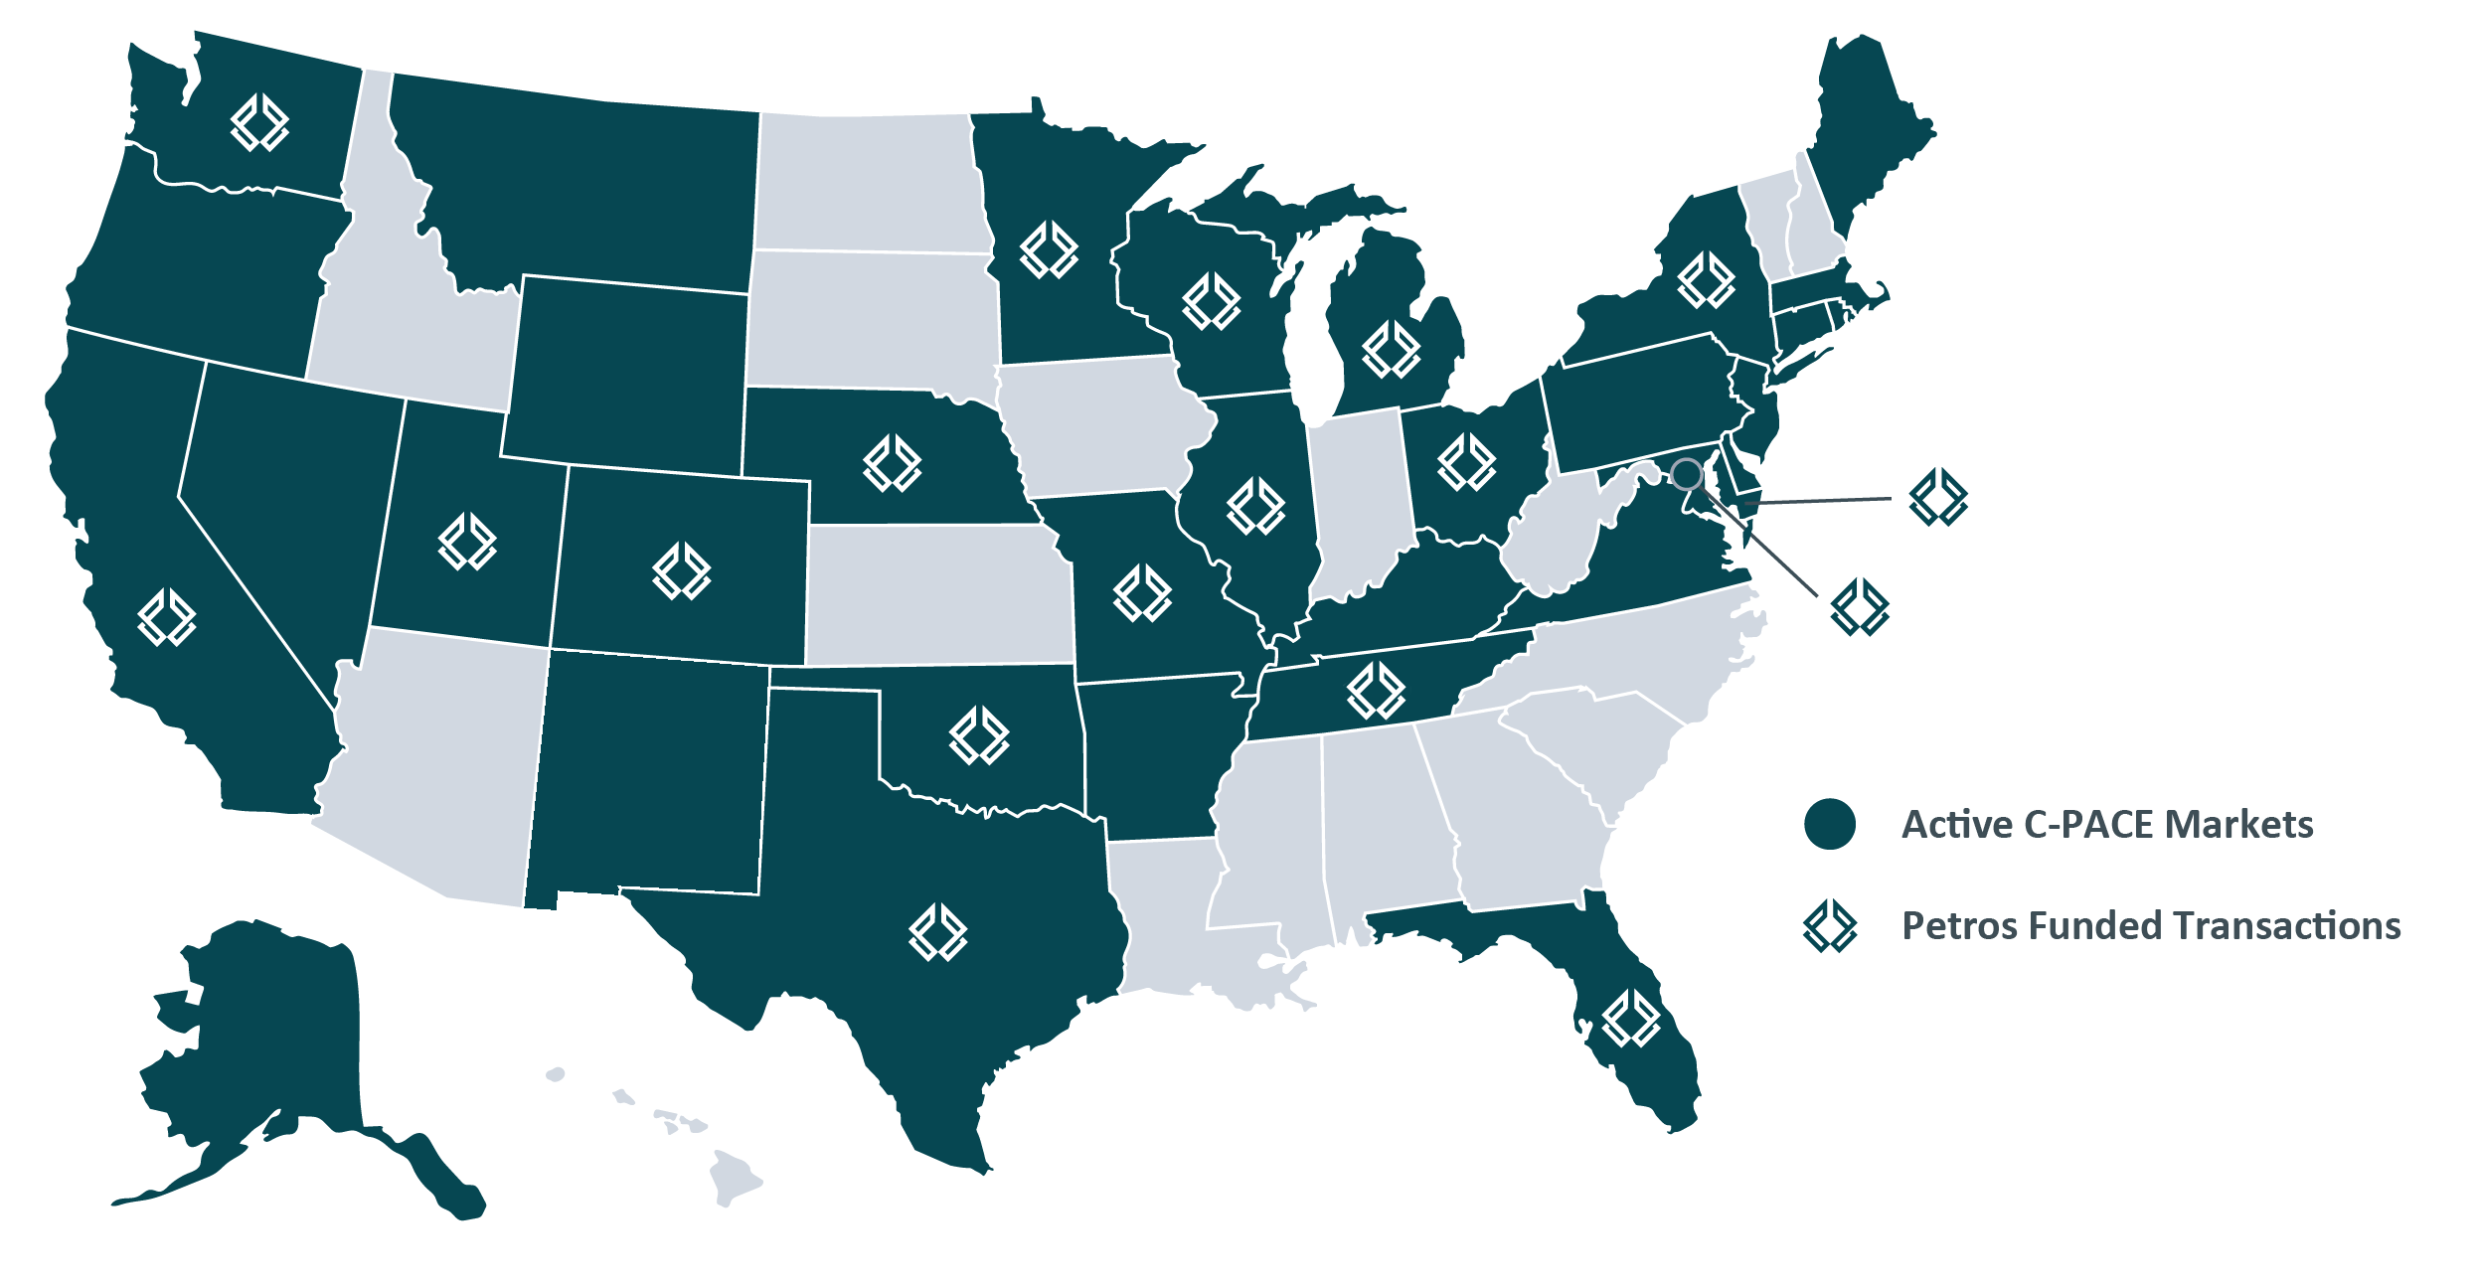
C-PACE Footprint
Where C-PACE Is Available
Petros can transact nationwide where there is an active C-PACE program and has the most experience in the C-PACE market, having funded projects in 17 states plus Washington, D.C.

Slide 8
Benefits of C-PACE
Low-cost, Long-term, Fixed-rate Financing
The unique assessment structure of C-PACE provides numerous benefits for property owners and developers. It can spread out the upgrade costs, free up your yearly budget, realize dramatic energy cost savings, and reduce your credit risk.
100% financing of hard and soft costs with no out-of-pocket
Displaces higher cost mezzanine and equity capital
Fixed-rate financing with up to 30-year terms
Increases net operating income and property value
Decreases utility and maintenance costs
Ability to recover as an operating expense
Facilitates sustainable building design
Promotes economic development and urban revitalization

Slide 9
Benefits for Owners
NO UPFR ONT C OS T S
NON- REC OUR SE, NON- A CCELER ATING
Efficiency projects financed by traditional loans or through equity might not meet internal hurdle rates so projects are often delayed indefinitely
PACE provides 100%, long-term financing of hard and soft costs with no out-of-pocket expenses
Most traditional forms of financing and energy performance contracts are recourse to the owner and accelerate upon sale or foreclosure
•
•
PACE is non-recourse after completion
Interest rate and payments are fixed over the 10-30 year term and under no circumstance, even default or bankruptcy, can they accelerate
•
•
Frees up operating and capital budgets
Cash flow positive from Day 1 in many instances
TRANSFERABLE PAYMENT OBLIG ATION
IMMEDI ATE LY CASH FLO W POSITIVE
Owners are typically hesitant to invest in long payback efficiency measures if it is possible they will sell the building before recovering their investment
PACE liens attach to the property and “run with the land”, automatically transferring from one owner to the next so the building owner only “pays for what he uses”
Underwriting based primarily on the property
Capital constrained property owners may not have budgetary capacity for efficiency projects with long payback periods
Long repayment periods (10-30 years) mean the annual PACE payments are typically lower than savings generated by efficiency project
Energy savings generated often outpace project costs plus the cost of financing (total PACE assessment) from Day 1
Owner keeps any tax credits and/or rebates as a result of the project

Slide 10
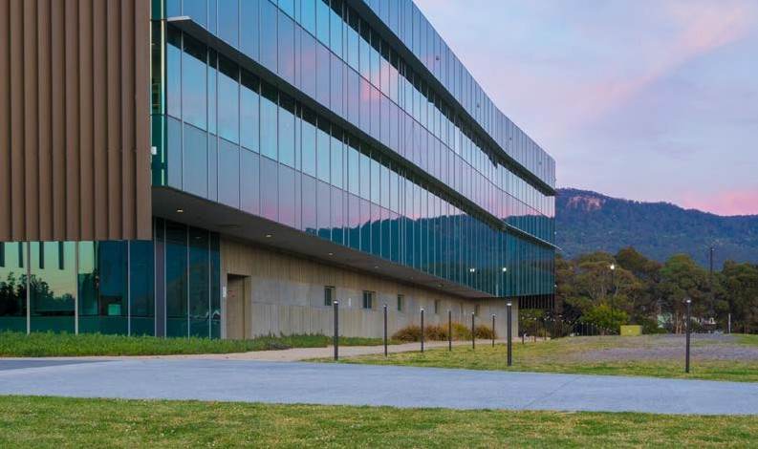
Benefits for Owners
REDUCED OPER ATING EXPENSE S
INCRE ASED PR OPER TY VALUE
U.S. businesses spend almost $200B/yr. on utilities, at least 30% of which is unnecessary
Some property owners might wonder what value will these improvements add to their property
PACE improvements extend the life of the building Building becomes more desirable to tenants Addresses deferred maintenance issues
•
•
•
Lower utility bills
•
•
•
Reduced maintenance expenses
Increases net operating income (NOI)
SOLVE SPLIT INCENTIVE LEASE STRUCTURES
Under many lease structures, when corporate capital is used to fund projects, savings generated go directly to the tenant’s bottom line resulting in negative cash on cash return for the owner
Due to the assessment mechanism, PACE is often passed to tenants for recovery in the same manner as property taxes
Tenants receive utility savings that outweigh the property tax assessment
Aligns property owner and tenant interests

Slide 11
The Structure of C-PACE
Underwriting Parameters
CRITERIA | REQUIREMENT S
Amortization | 15-30 years, may not exceed useful life of funded PACE measures
Geography | All active PACE jurisdictions; subject to MSA and RUCA parameters
PACE LTV | Up to 30% as-stabilized value
Combined LTV (PACE + Debt) | Up to 95% as-stabilized value
Combined DSCR* | Minimum of 1.15x at stabilization
Capitalized Interest Period | Not to exceed 36 months
Energy Savings | Energy audit required, varies per state statute and program guidelines
Insurance | Petros added as additional insured to Property/Builder’s Risk policy
Environmental | No un-remediated RECs
Recourse | Non-recourse after construction
Collateral | Special assessment lien
Mortgage Lender Consent | Written lender acknowledgment required if property is mortgaged
Completion Guaranty | Required on new construction and gut rehabs
Payment & Performance Bonds | Applicable on new construction and gut rehabs, Petros to be named additional beneficiary
Construction Inspections | Third party engineering/inspection firm to review all draw requests, Petros to approve prior to disbursements
*PACE assessment treated as below-the-NOI-line debt service; NOI includes project efficiency savings resulting from PACE retrofit measures
Requirements may vary by program

Slide 12
Retroactive C-PACE Financing
Create Liquidity and Stability
In most states with active C-PACE programs, recently completed and on-going construction projects may be able to secure C-PACE financing retroactively.
Benefits of Recapitalizing with C-PACE Financing
Retroactive C-PACE allows for the refinancing of up to 30% LTV of the capital stack for qualified hard and soft cost expenditures, providing borrowers with the ability to:
SE CURE A MORE EFFICIENT CAPITAL SOUR CE | Fixed rates at less than half the cost of mezzanine or pref equity structures
DEFER NE AR- TERM PAYMENT S AND FREE- UP CASH FLO W | Capitalize interest only payments for up to 36 months
IMPR OVE ABILITY TO SER VICE DEBT | Assessment terms of typically 20-30 years help lower annual payment obligations
E S TABLISH A C OS T REC OVERY VEHICLE | Special assessment payment structure offers ability for owners to recover all or a portion of the cost of the improvements from building tenants or hotel guests
LOCK- IN NON- REC OUR SE FINANCING | No ongoing covenants or recourse required after construction is complete
Potential Use of Funds
Replenish Operating Reserves
Fund Cost Overruns
Service Existing Debt

Slide 13
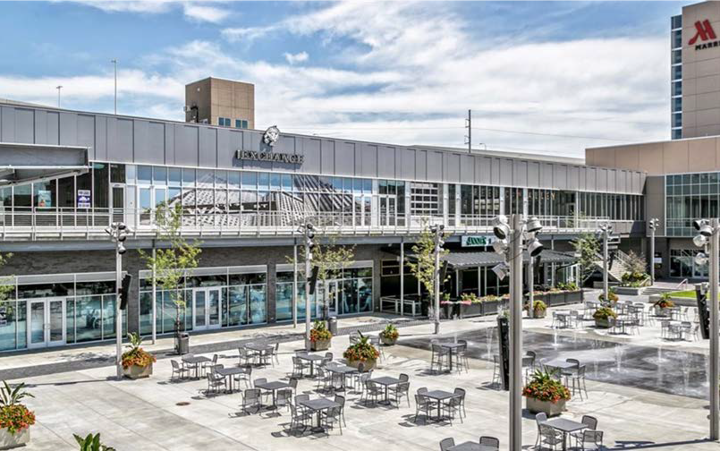
Petros Portfolio Client Case Study
Mixed-Use
Shamrock Development, Inc. secured C-PACE funding for their $205M Capitol District mixed-use development in downtown Omaha, Nebraska.
C- PA CE FUNDING:
$24.9M
PR OPER TY TYPE:
333-room Marriott hotel, 223-unit apartment building, and 90,000 SF of retail
S C O P E O F W O R K F U N D E D BY C-PA C E :
Roofing, heat pumps, interior and exterior lighting, and domestic water fixtures
“It was great working with the Petros PACE Finance team. Their experience handling large C-PACE transactions is unparalleled. The PACE financing solution will provide long- term stability for our capital stack, and it pays us back for a significant investment in energy efficiency throughout the Capitol District.“
– Mike Moylan, President of Shamrock Development

Slide 14
Petros Portfolio Client Case Study
Hospitality
In February 2021, the Kor Group secured $21.4M of C-PACE to refinance PACE improvements that were recently installed during the renovation of the historic Flatiron Building, transforming it into the San Francisco Proper Hotel.
C- PA CE FUNDING:
$21.4M
PR OPER TY TYPE:
131-key luxury boutique hotel
S C O P E O F W O R K F U N D E D BY C-PA C E :
Full seismic upgrade, brand-new building systems, acoustic windows, modernized elevators, and ADA lifts

Slide 15
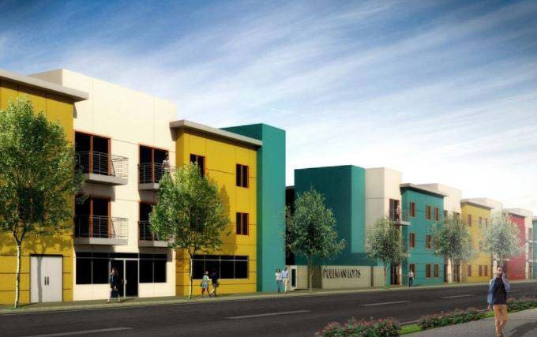
Petros Portfolio Client Case Study
Multifamily
Phoenix Development Corporation utilized C-PACE to fund energy efficient new construction of Pullman Lofts in Santa Rosa, California.
C- PA CE FUNDING:
$9.7M
PR OPER TY TYPE:
74-unit multifamily property
S C O P E O F W O R K F U N D E D BY C-PA C E :
Building envelope, upgrades to plumbing, electrical, and mechanical systems

Slide 16
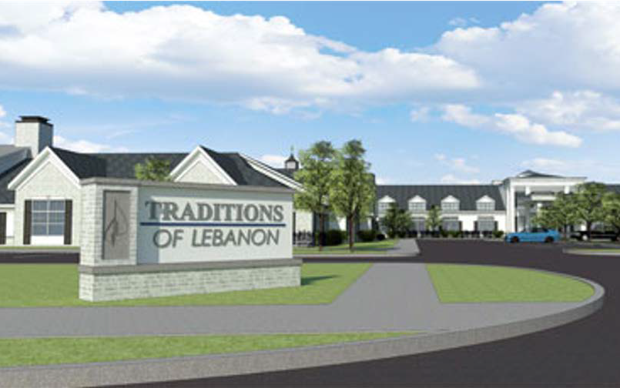
Petros Portfolio Client Case Study
Senior Living
Leo Brown Group utilized C-PACE funding for energy efficiency measures incorporated in the new construction of the Traditions of Lebanon senior living community in Lebanon, Ohio.
C- PA CE FUNDING:
$7.9M
PR OPER TY TYPE:
146-unit senior living community
S C O P E O F W O R K F U N D E D BY C-PA C E :
Comprehensive building envelope and slab upgrade, LED lighting, and HVAC
“Our mission is to develop vibrant and functional settings that serve the needs of our residents. C-PACE financing is a tremendously valuable source of funding that allows us to accomplish our mission in a more cost-effective manner. The Petros team seamlessly integrated the C-PACE financing, facilitating a smooth closing process with all the transaction parties.”
– Chris King, Vice President of Finance at Leo Brown Group

Slide 17
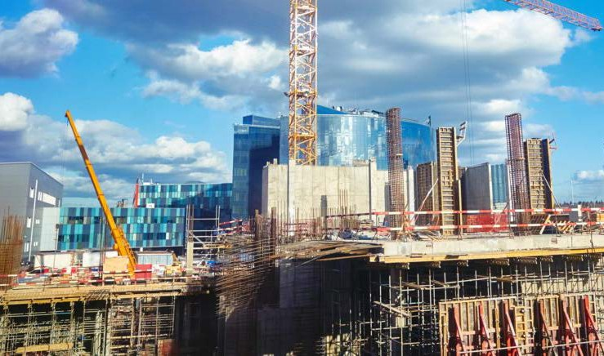
Petros PACE Finance Overview
Leading National C-PACE Capital Provider
EXECUTION EXCELLENCE
Petros is the national leader in the C-PACE marketplace, dedicated solely to providing long-term C-PACE financing to commercial property owners and developers.
SIGNIFICANT C OMMIT TED CAPI TAL
With strategic capital partners in place, Petros has billions of dollars of committed capital to fund C-PACE assessments from $500K to $200M+.
N ATIONWIDE C OVERA GE
Petros is an approved capital provider in the majority of approved C-PACE markets and has closed transactions in 17 states plus Washington, D.C.
UNM ATCHED EXPERIENCE
Founded in 2013, Petros has played a key leadership role in building and expanding the C-PACE industry since its earliest days.

Slide 18
Contact Us
NICOLE ROBBEN
VP – Originations
nicole@petrospartners.com
(414) 708-1072

